Slide 1
Riverview
School Bus
Orientation

Slide 2
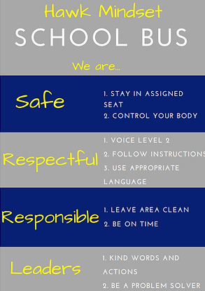
Goals for Today’s Orientation
Keeping everyone safe on the bus
Making sure everyone feels welcome and comfortable

Slide 3
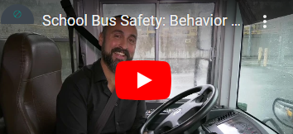
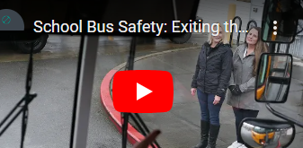
Safe
Do not distract the driver
Stay in assigned seat facing forward; hands to yourself
Backpacks on your lap or on the floor
Keep the aisle clear. Do not lean out in the aisle

Slide 4
Respectful
Follow instructions
Use appropriate language; no inappropriate gestures
Be patient, no pushing or shoving
Use voice level 2; normal voice, table talk

Slide 5
Responsible
Do not bring dangerous or prohibited items on the bus
Water only No eating on the bus.
Leave the bus clean
Be on time

Slide 6
Leaders
Use kind words and actions
Set a good example, be a good Hawk
Alert the driver to any unsafe conditions
Help other students who need assistance

Slide 7
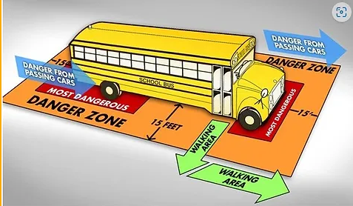
Staying Safe Getting On and Off the Bus
Stay in line and get on the bus one at a time
At school, stay seated until your driver tells you it is time to depart
No pushing or shoving. Use the handrails
Stay out of the danger zone
Walk directly off the bus and at least 15 feet away from the bus
Never walk behind the bus or directly in front of the bus
Always be on the look out for passing cars

Slide 8
Let’s Go

